Slide 1
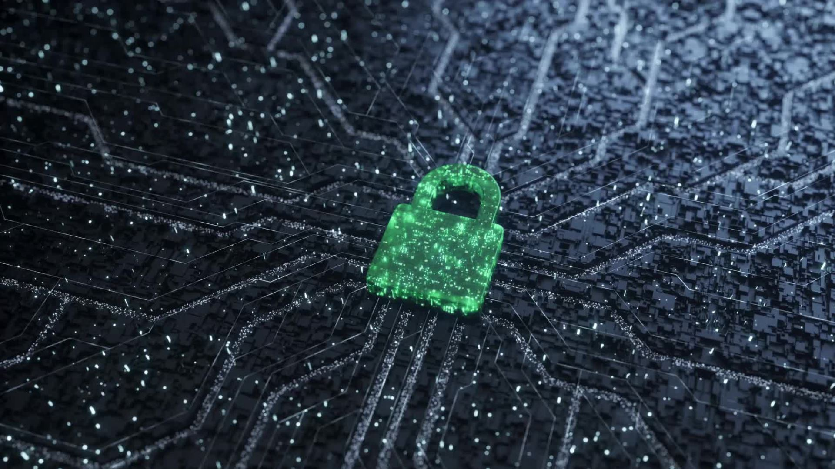
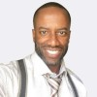
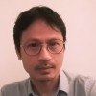
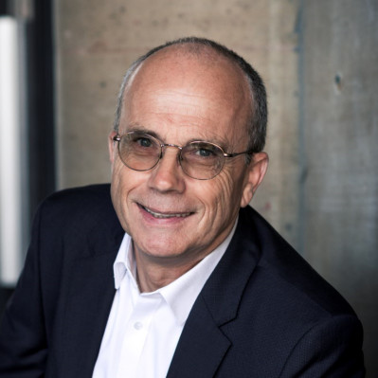
Fraud Detection
Dominique OURMIAH
Patrice SINNAH
Philippe BAUCOUR

Slide 2
Infra

Slide 3
Take away

